Slide 1

CSC241: Data Structures and Algorithms
Linked List
Dr. Ashik Ahmed Bhuiyan
Many of the slides were adopted from Dr. Si Chen

Slide 2
Today’s Topics
Introduction to Linked Lists
Linked List Operations
Doubly Linked and Circularly Linked Lists
Recursion on Linked Lists
10

Slide 3
Elementary Facts About Lists
A list is a collection of objects organized in a sequence.
Each list element is assigned an integer index based on its position in the sequence.
The first element in the sequence has index 0, and each succeeding element has index 1 greater than its predecessor.
Array
Linked Lists
10

Slide 4
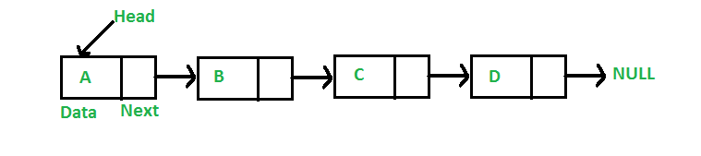
Linked Lists && Array → What’s the difference
Array
index 0
index 1
index 2
index 3
Linked List
10

Slide 5
Array Advantage
An array use contiguous memory allocation.
In contiguous allocation, list elements occupy consecutive memory locations.
A | B | C
index 0
index 1
index 2
index 3
10

Slide 6
Array Advantage
Access to a contiguously allocated list element is very fast:
Given any index k, we can compute the memory address of the list element at that position by adding the size (in bytes) of k items to the address of the first element in the list.
Contiguous allocation is said to allow random access because we can directly jump to any given element without going through its predecessors.
index 0
index 1
index 2
index 3
10

Slide 7

Array Disadvantage
Insertion or deletion of elements in the middle of the list involves the laborious relocation of all elements that come after.
If a list has a thousand elements, then to insert a new element at position 5 means all elements from position 5 on up must be moved up.
This overhead is bad for applications that do a lot of insertions and deletions.
10

Slide 8
Why Linked List?
000
080
200
040
In linked allocation, the list keeps a reference to its first element: this is the head reference
Every element in the list keeps a reference to its successor, the element that follows it on the list.
Memory for list elements does not have to be consecutive.
10

Slide 9
Why Linked List?
Advantages over arrays
Dynamic size
Ease of insertion/deletion
Any disadvantage of linked list???
10

Slide 10
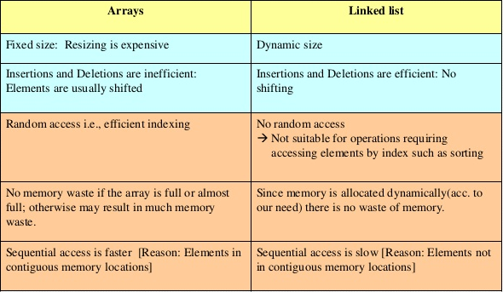
Comparison
10

Slide 11
Nodes and Links
The objects that hold the list element and the reference (link) to its successor are called nodes.
The references to successors are called successor links.
head
Index 3
index 1
index 2
index 0
10

Slide 12
Disadvantages of Linked Allocation
Given a node in the list, we can only access it by starting at the first node and following the successor links till we come to the desired node.
This is called sequential access.
Sequential access takes a lot longer than random access to get to nodes near the end of a long list (compare with an array).
10

Slide 13

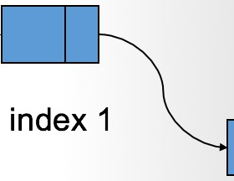
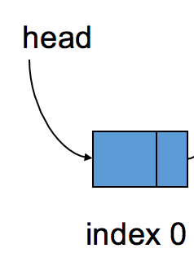
Java Implementation of Linked Lists
Requires an implementation of a node object.
A list is represented using a reference to the node with the first element.
Each node has a reference to its successor, which is the last node is set to null.
a node object
LinkedList → reference to the head node

Slide 14
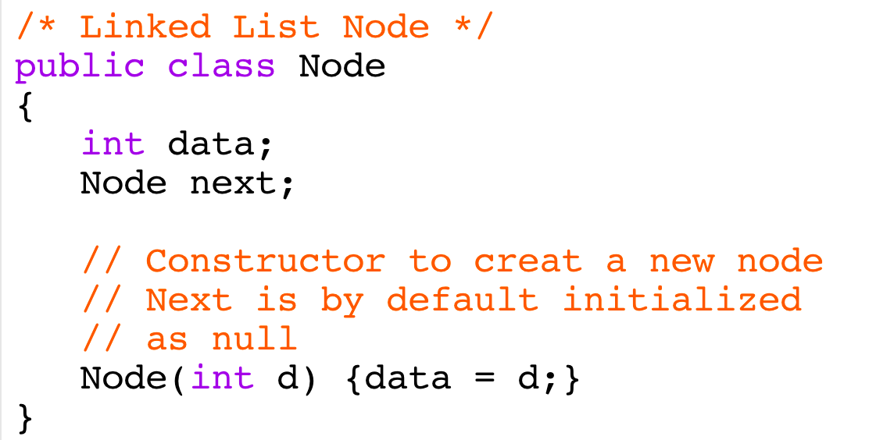

Java Implementation of Linked List
A class that implements a node must hold a list element plus a successor link:
a node object
14

Slide 15
Creation of Linked Lists
104
100
head
fourth
second
103
99
third
first

Slide 16
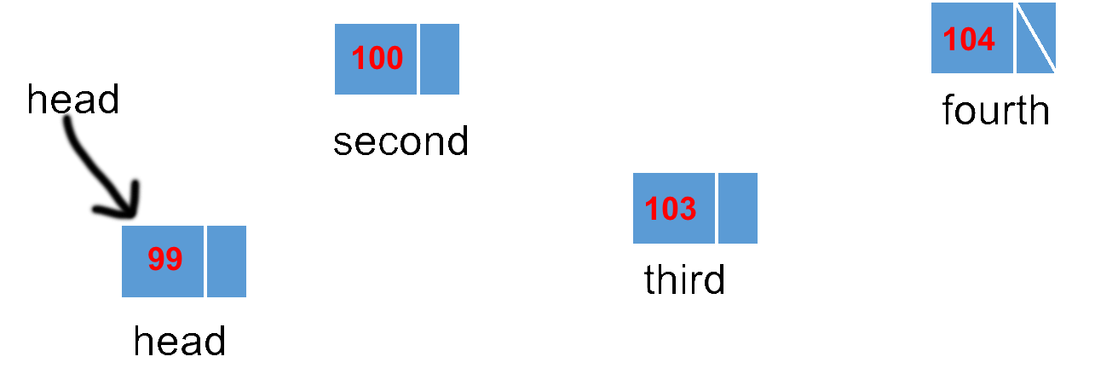
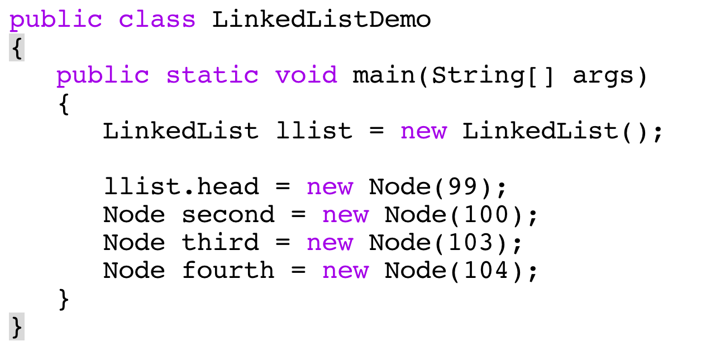
Creation of Linked Lists

Slide 17
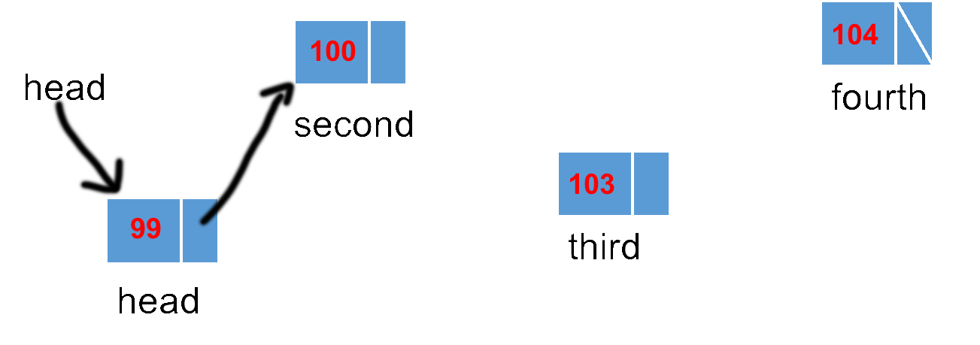
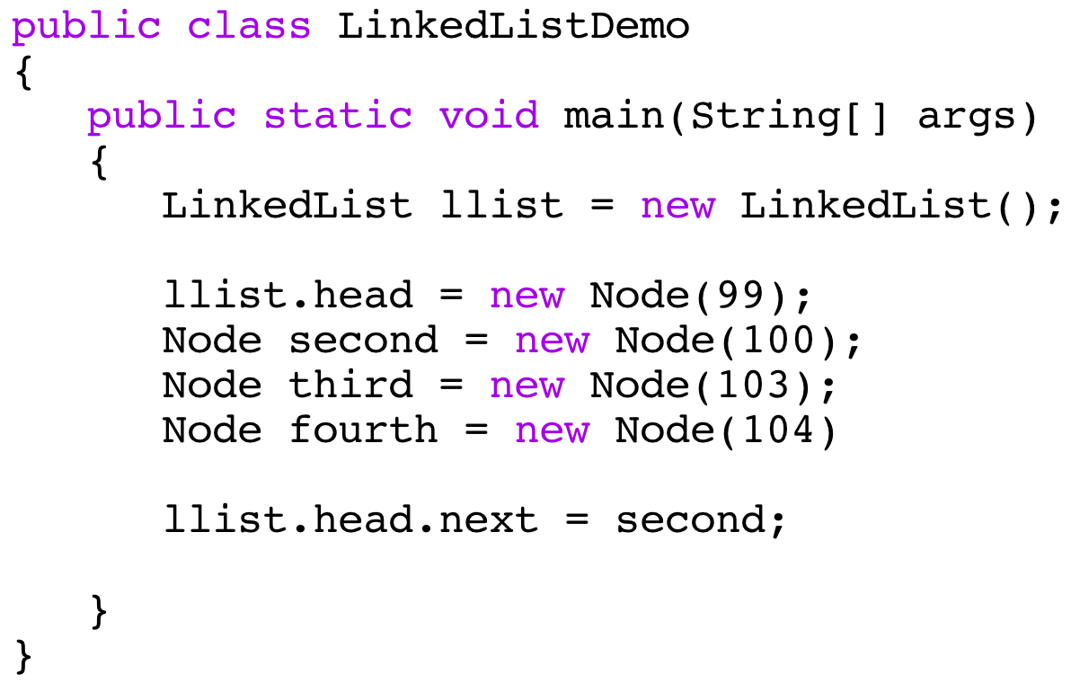
Creation of Linked Lists

Slide 18
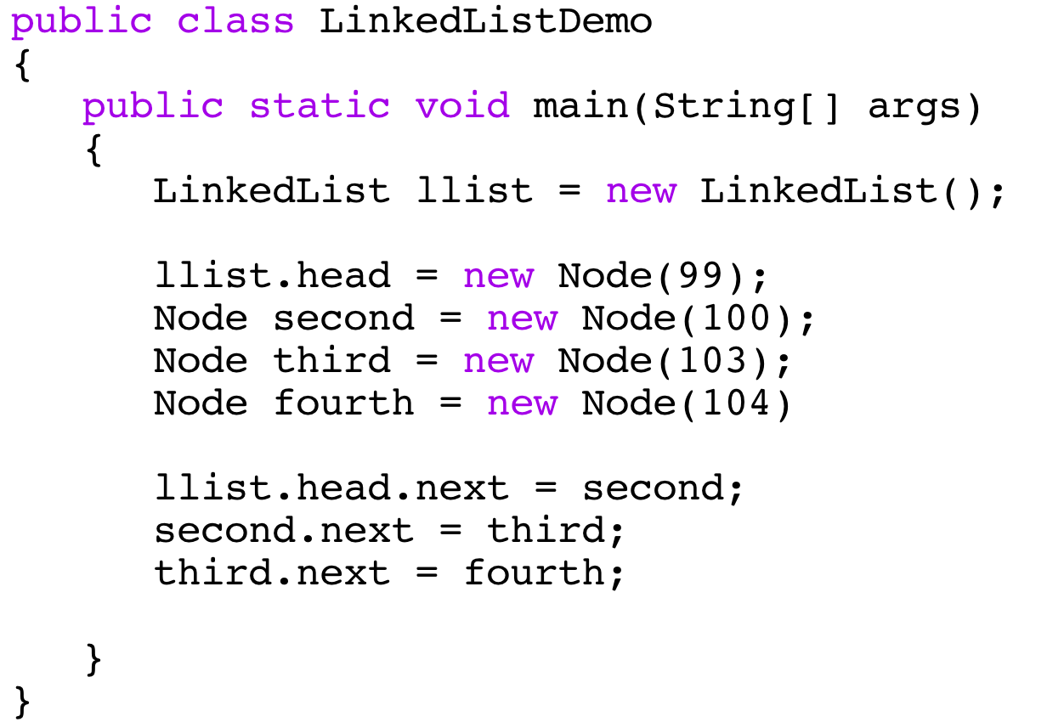
Creation of Linked Lists
104
100
head
fourth
second
103
99
third
head

Slide 19
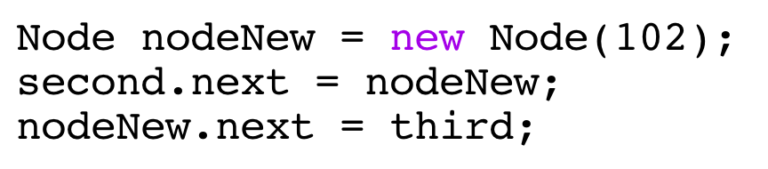
Inserting Nodes
104
100
head
fourth
second
103
99
third
head
102
nodeNew

Slide 20

Removing a Node
104
100
head
fourth
second
103
99
third
head
To remove the first node of a list, set the head reference to its successor:

Slide 21
Removing a Node
To remove a node other than the first:
Set a reference to the predecessor of the targeted node.
Route the successor link in the predecessor around the targeted node.
104
100
head
fourth
second
103
99
third
102
head
nodeNew

Slide 22
Removing a Node
104
100
head
fourth
second
103
99
third
head
102
nodeNew

Slide 23
Traversal of a Linked List
A traversal of a linked list is a systematic method of examining, in order, every element of the list.
A traversal usually performs some operation as it visits each element.

Slide 24
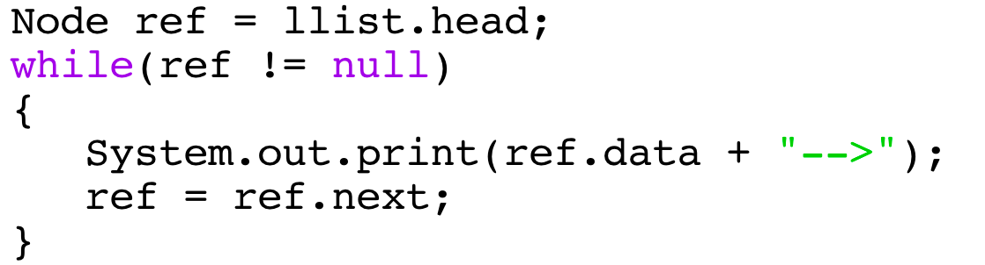
Traversal of a Linked List
To traverse a linked list, start a reference at the head of the list, and keep moving it from a node to a successor:
104
100
head
fourth
second
103
99
third
first

Slide 25
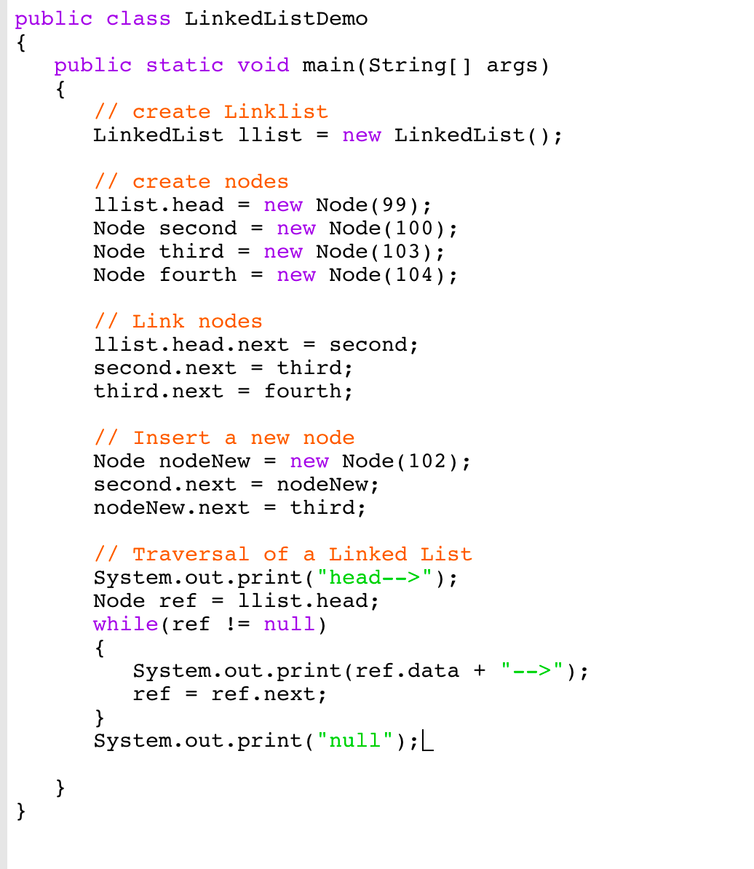
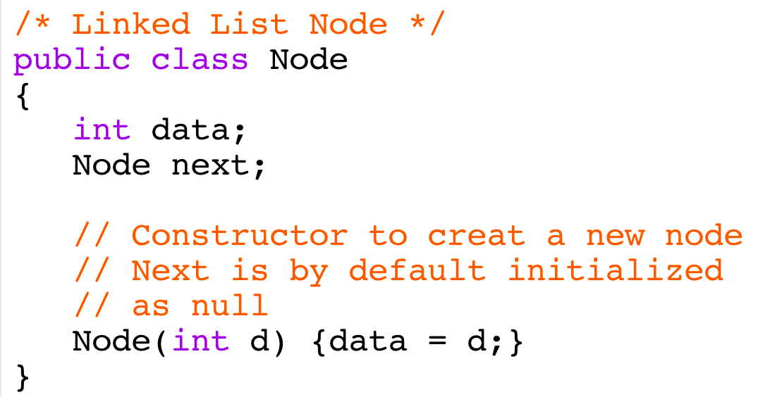


Slide 26
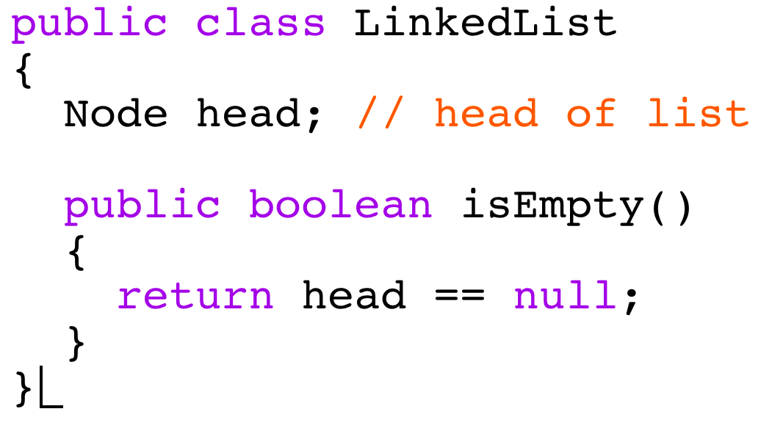
Checking for an Empty List
A list is empty when head is equal to null:
27

Slide 27
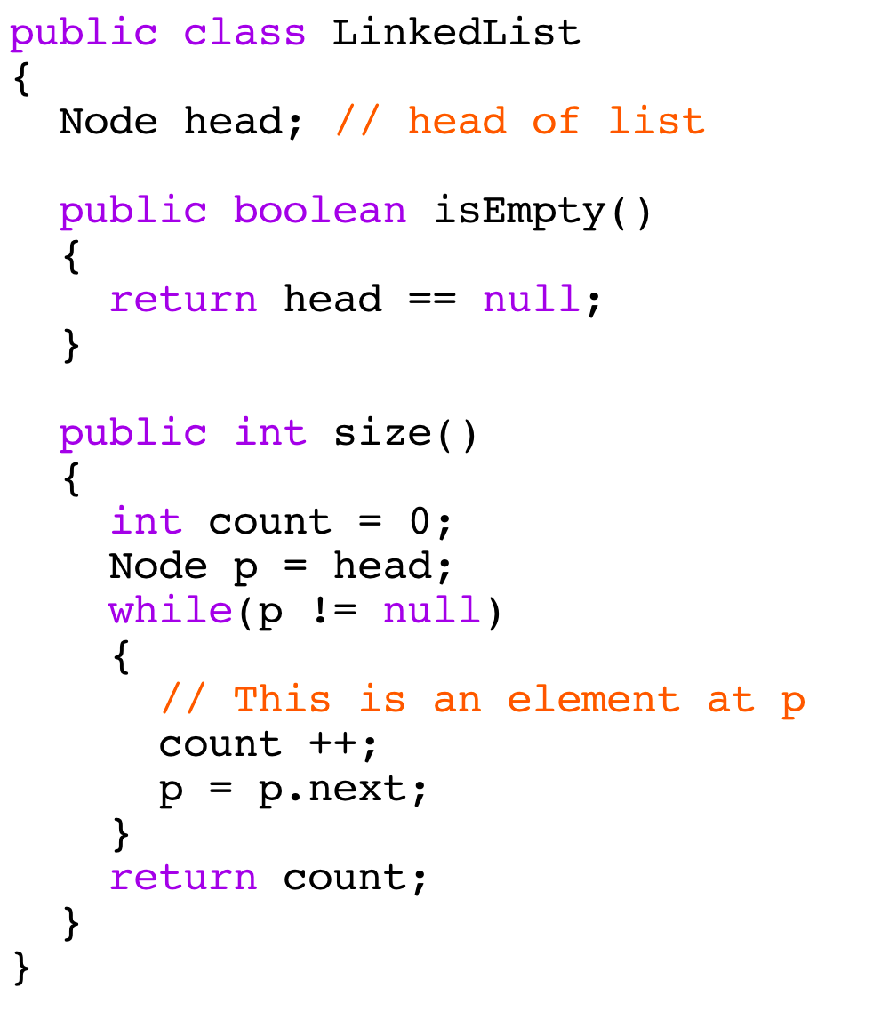
Determining the Size of a List
This is done by traversing the list while incrementing a count for each node visited:
28

Slide 28
Adding to the End of the List
To add Node e, consider two cases:
If list is empty:
head= new Node(e);
If list is not empty: last.next = new Node(e);

Slide 29
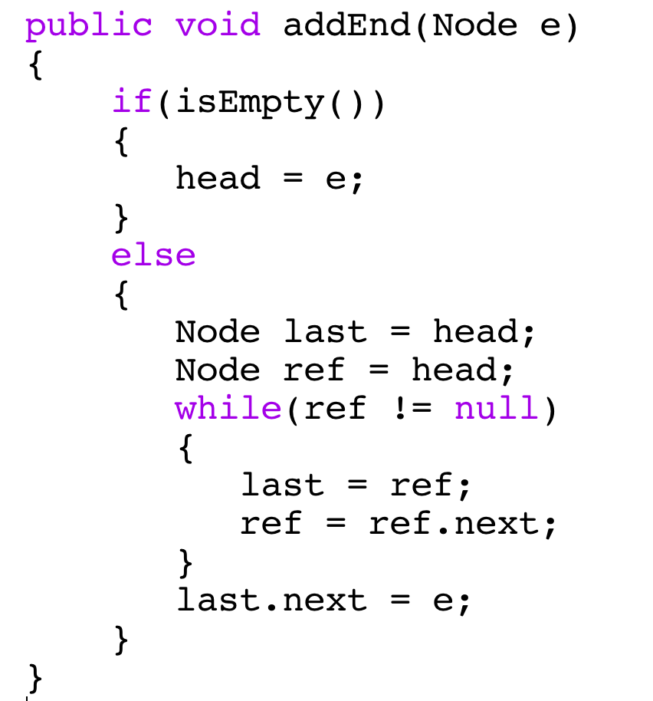
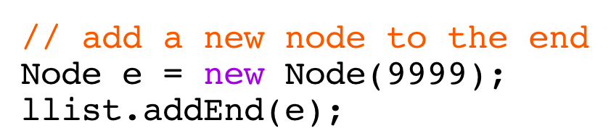
Adding to the End of the List

Slide 30
Adding an Element at a Given Index
Check index: if out of bounds, throw an exception.
Is index 0? Put new element at beginning of the list.
Is index > 0? Skip index nodes from beginning of the list and splice in the new node.

Slide 31
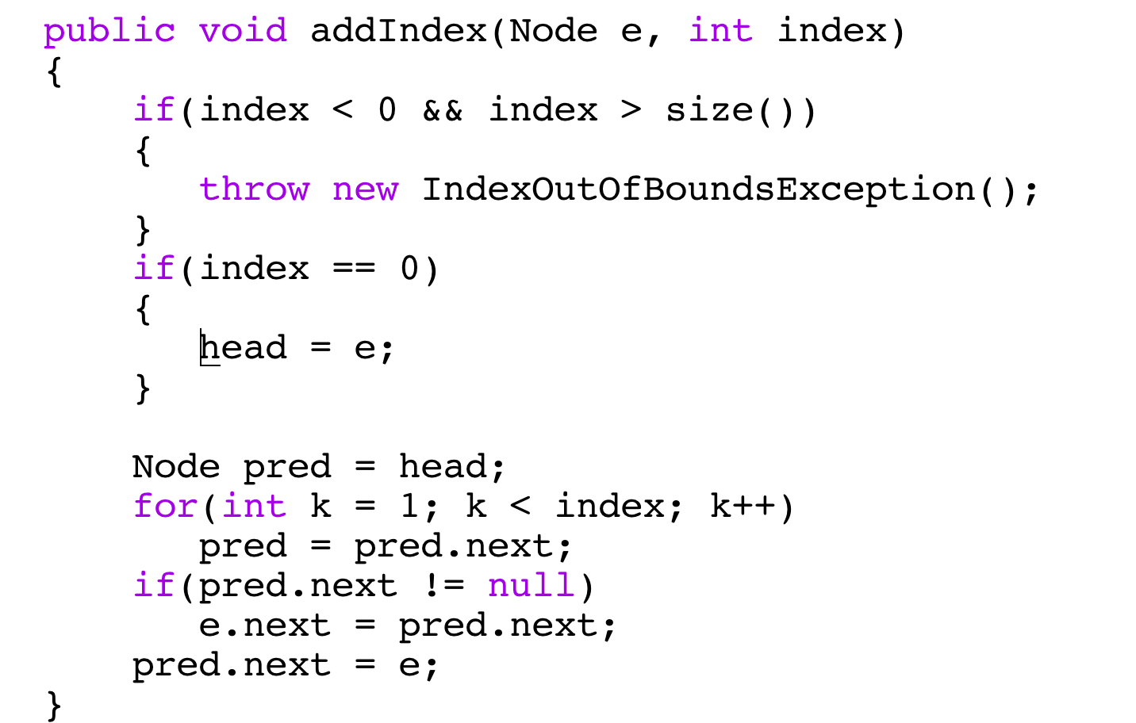
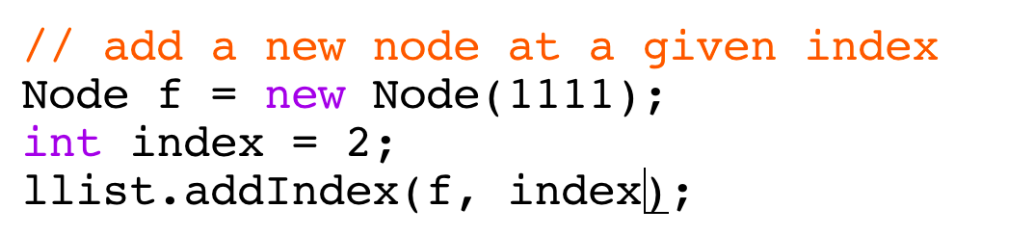
Adding an Element at a Given Index
32

Slide 32
Removing a List Element Based on Value
Use a list traversal to locate the node containing the given value, return false if there is no such node.
If the target node is the first node, remove it by moving first forward and then return true.
Otherwise, find the predecessor of the target node and remove the target node.
33

Slide 33
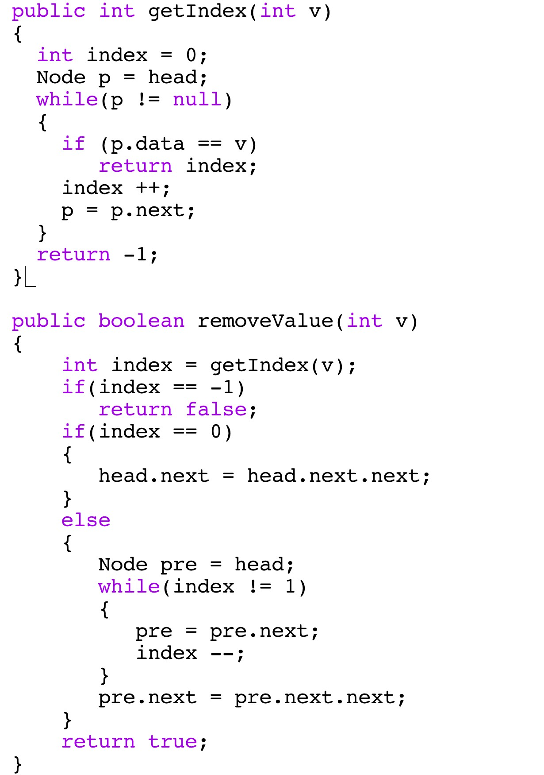
Use a list traversal to locate the node containing the given value, return false if there is no such node.
If the target node is the first node, remove it by moving first forward and then return true.
Otherwise, find the predecessor of the target node and remove the target node.

